Slide 1
DISTRIBUTED SYSTEMS
Principles and Paradigms
Second Edition
ANDREW S. TANENBAUM
MAARTEN VAN STEEN
modified by A. Dobra and R. Newman 2012/2013
Chapter 1
Introduction
Tanenbaum & Van Steen, Distributed Systems: Principles and Paradigms, 2e, (c) 2007 Prentice-Hall, Inc. All rights reserved. 0-13-239227-5

Slide 2
What is an Operating System
An operating system is:
A collection of software components that
Provides useful abstractions and
Manages resources to
Support application programs, and
Provide an interface for users and programs
Tanenbaum & Van Steen, Distributed Systems: Principles and Paradigms, 2e, (c) 2007 Prentice-Hall, Inc. All rights reserved. 0-13-239227-5

Slide 3
Operating System Functions
An operating system’s main functions are to:
Schedule processes & multiplex CPU
Provide mechanisms for IPC and synchronization
Manage main memory
Manage other resources
Provide convenient persistent storage (files)
Maintain system integrity, handle failures
Enforce security policies (e.g., access control)
Give users and processes an interface
Tanenbaum & Van Steen, Distributed Systems: Principles and Paradigms, 2e, (c) 2007 Prentice-Hall, Inc. All rights reserved. 0-13-239227-5

Slide 4
Definition of a Distributed System (1)
A distributed system is (Tannenbaum):
A collection of independent computers that appears to its users as a single coherent system.
A distributed system is (Lamport):
One in which the failure of a computer you didn't even know existed can render your own computer unusable
Tanenbaum & Van Steen, Distributed Systems: Principles and Paradigms, 2e, (c) 2007 Prentice-Hall, Inc. All rights reserved. 0-13-239227-5

Slide 5
Properties of Distributed Systems
Concurrency
  Multicore systems
  Multiple hosts
No global clock
  Theoretical impossibility
  Expense of accurate clocks
Independent view
  Message delay, failure
  Impossible to distinguish slow vs. failed node
Independent failure
  Message delivery (loss, corruption)
  Nodes
Tanenbaum & Van Steen, Distributed Systems: Principles and Paradigms, 2e, (c) 2007 Prentice-Hall, Inc. All rights reserved. 0-13-239227-5

Slide 6
Software Concepts
System | Description | Main Goal
DOS | Tightly-coupled operating system for multi-processors and homogeneous multicomputers | Hide and manage hardware resources
NOS | Loosely-coupled operating system for heterogeneous multicomputers (LAN and WAN) | Offer local services to remote clients
Middleware | Additional layer atop of NOS implementing general-purpose services | Provide distribution transparency
An overview of
NOS (Network Operating Systems) (80’s)
DOS (Distributed Operating Systems) (90’s)
Middleware (00’s)
Tanenbaum & Van Steen, Distributed Systems: Principles and Paradigms, 2e, (c) 2007 Prentice-Hall, Inc. All rights reserved. 0-13-239227-5

Slide 7
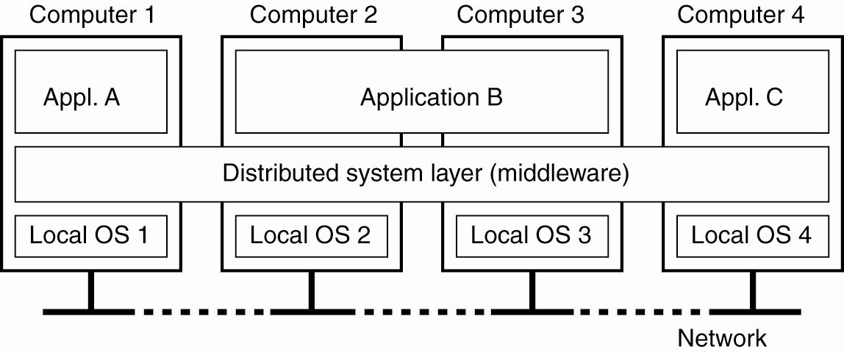
Definition of a Distributed System (2)
Figure 1-1. A distributed system organized as middleware. The middleware layer extends over multiple machines, and offers each application the same interface.
Tanenbaum & Van Steen, Distributed Systems: Principles and Paradigms, 2e, (c) 2007 Prentice-Hall, Inc. All rights reserved. 0-13-239227-5

Slide 8
Goals
Making Resources Accessible
Distribution Transparency
Openness
Scalability
Tanenbaum & Van Steen, Distributed Systems: Principles and Paradigms, 2e, (c) 2007 Prentice-Hall, Inc. All rights reserved. 0-13-239227-5

Slide 9
Making Resources Accessible
The main goal of a distributed system is to make it easy for the users to access remote resources, and to share them in a controlled and efficient way.
Resources can be like printers, computers, storage facilities, data, files, Web pages, and networks etc.
Tanenbaum & Van Steen, Distributed Systems: Principles and Paradigms, 2e, (c) 2007 Prentice-Hall, Inc. All rights reserved. 0-13-239227-5

Slide 10
Distribution Transparency
Goal of a distributed system is to hide the fact that its processes and resources are physically distributed across multiple computers.
The concept of transparency can be applied to several aspects of a distributed
system
Tanenbaum & Van Steen, Distributed Systems: Principles and Paradigms, 2e, (c) 2007 Prentice-Hall, Inc. All rights reserved. 0-13-239227-5

Slide 11
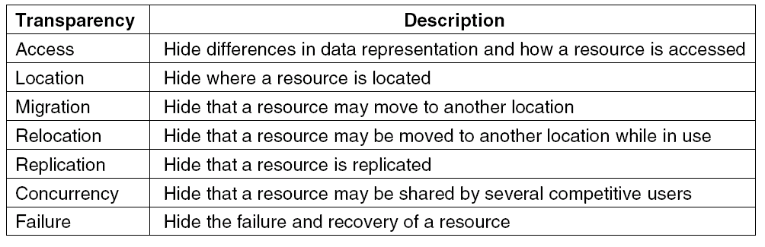
Transparency in a Distributed System
Figure 1-2. Different forms of transparency in a distributed system (ISO, 1995).
Other forms:
Parallelism – Hide the number of nodes working on a task
Size – Hide the number of components in the system
Revision – Hide changes in software/hardware versions
Tanenbaum & Van Steen, Distributed Systems: Principles and Paradigms, 2e, (c) 2007 Prentice-Hall, Inc. All rights reserved. 0-13-239227-5

Slide 12
Openness
An open distributed system is a system that offers services according to standard rules that describe the syntax and semantics of those services.
In distributed systems services are generally specified through interfaces, which are often described in an Interface Definition Language (IDL).
They specify precisely the names of the functions that are available together with types of the parameters, return values, possible exceptions that can be raised, and so on.
Tanenbaum & Van Steen, Distributed Systems: Principles and Paradigms, 2e, (c) 2007 Prentice-Hall, Inc. All rights reserved. 0-13-239227-5

Slide 13
Challenges
Performance
Concurrency
Failures
Scalability
System updates/growth
Heterogeneity
Openness
Multiplicity of ownership, authority
Security
Quality of service/user experience
Transparency
Debugging
Tanenbaum & Van Steen, Distributed Systems: Principles and Paradigms, 2e, (c) 2007 Prentice-Hall, Inc. All rights reserved. 0-13-239227-5

Slide 14
Approaches
Virtual clocks
Group communication
Heartbeats/failure detection, group membership
Distributed agreement, snapshots
Leader election
Transaction protocols
Redundancy, replication, caching
Indirection - naming
Distributed mutual exclusion
Middleware, modularization, layering
  Decomposition vs. integration
Cryptographic protocols
Tanenbaum & Van Steen, Distributed Systems: Principles and Paradigms, 2e, (c) 2007 Prentice-Hall, Inc. All rights reserved. 0-13-239227-5

Slide 15
Scalability
Scalability of a system can be measured at three different dimensions
Size: meaning that we can easily add more users and resources to the system
geographically scalable system is one in which the users and resources may lie far apart.
a system can be administratively scalable-it can still be easy to manage even if it spans many independent administrative organizations
Tanenbaum & Van Steen, Distributed Systems: Principles and Paradigms, 2e, (c) 2007 Prentice-Hall, Inc. All rights reserved. 0-13-239227-5

Slide 16
Challenges in Scalable Ds
Controlling the cost of physical resources
Controlling of performance loss
Preventing software resource running out
Avoiding performance bottlenecks
Tanenbaum & Van Steen, Distributed Systems: Principles and Paradigms, 2e, (c) 2007 Prentice-Hall, Inc. All rights reserved. 0-13-239227-5

Slide 17
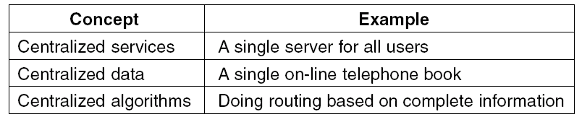
Scalability Problems
Figure 1-3. Examples of scalability limitations.
Distributed systems – many theoretical results on lower bounds of tradeoffs that limit practical solutions
Tanenbaum & Van Steen, Distributed Systems: Principles and Paradigms, 2e, (c) 2007 Prentice-Hall, Inc. All rights reserved. 0-13-239227-5

Slide 18
Scalability Problems
Characteristics of decentralized algorithms:
  No machine has complete information about the system state.
  Machines make decisions based only on local information.
  Failure of one machine does not ruin the algorithm.
  There is no implicit assumption that a global clock exists.
Tanenbaum & Van Steen, Distributed Systems: Principles and Paradigms, 2e, (c) 2007 Prentice-Hall, Inc. All rights reserved. 0-13-239227-5

Slide 19
Scaling Techniques (2)
There are basically only three techniques for scaling:
hiding communication latencies,
Distribution
Replication
Tanenbaum & Van Steen, Distributed Systems: Principles and Paradigms, 2e, (c) 2007 Prentice-Hall, Inc. All rights reserved. 0-13-239227-5

Slide 20
Hiding communication latencies
It is important to achieve geographical scalability.
The basic idea is to avoid waiting for responses to remote service requests as much as possible.
There are many applications that cannot make effective use of asynchronous communication
In such cases, a much better solution is to reduce the overall communication
Tanenbaum & Van Steen, Distributed Systems: Principles and Paradigms, 2e, (c) 2007 Prentice-Hall, Inc. All rights reserved. 0-13-239227-5

Slide 21
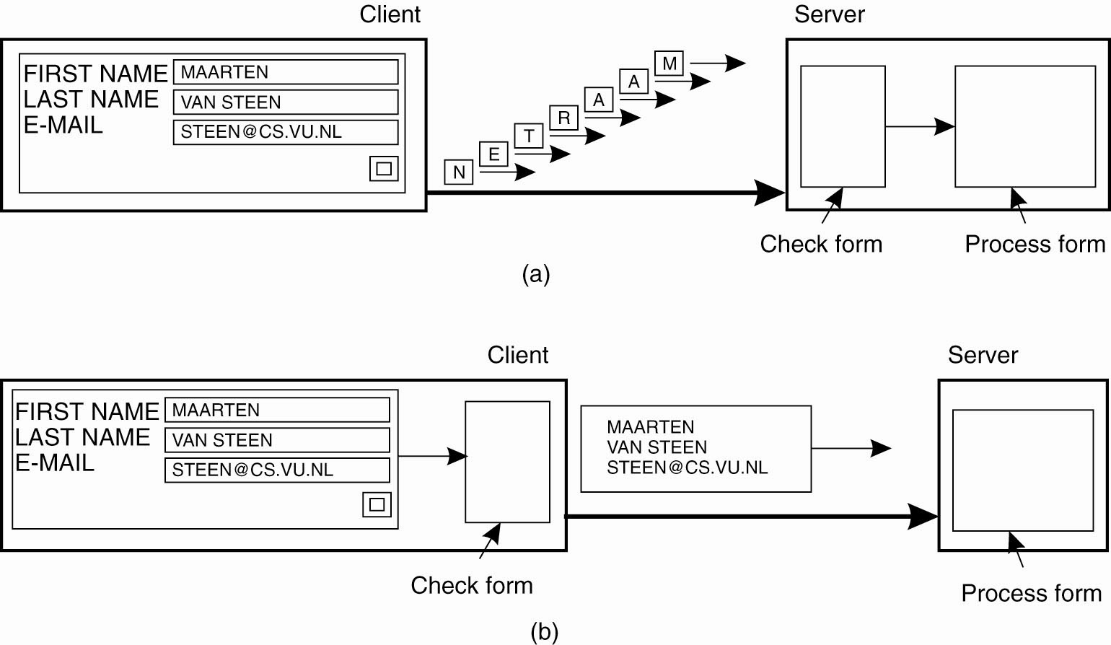
Scaling Techniques (1)
Figure 1-4. The difference between letting (a) a server or (b) a client check forms as they are being filled.
Tanenbaum & Van Steen, Distributed Systems: Principles and Paradigms, 2e, (c) 2007 Prentice-Hall, Inc. All rights reserved. 0-13-239227-5

Slide 22
Distribution
Distribution involves taking a component, splitting it into smaller parts, and subsequently spreading those parts across the system
Example of distribution is the Internet Domain Name System (DNS)
The DNS name space is hierarchically organized into a tree of domains, which are divided into non overlapping zones
The names in each zone are handled by a single name server
another example the World Wide Web
Tanenbaum & Van Steen, Distributed Systems: Principles and Paradigms, 2e, (c) 2007 Prentice-Hall, Inc. All rights reserved. 0-13-239227-5

Slide 23
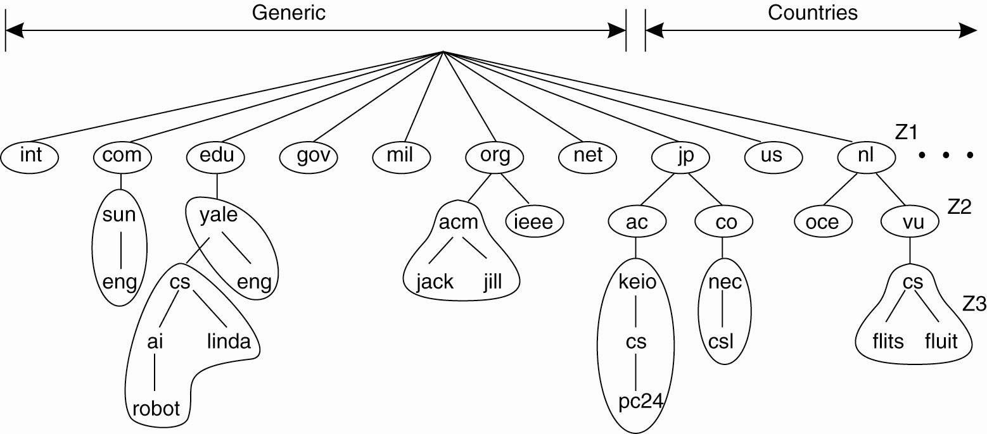
Scaling Techniques (2)
Figure 1-5. An example of dividing the DNS
name space into zones.
Tanenbaum & Van Steen, Distributed Systems: Principles and Paradigms, 2e, (c) 2007 Prentice-Hall, Inc. All rights reserved. 0-13-239227-5

Slide 24
Replication
Replicate components across a distributed system.
Replication increases availability
Balance the load between components leading to better performance
Tanenbaum & Van Steen, Distributed Systems: Principles and Paradigms, 2e, (c) 2007 Prentice-Hall, Inc. All rights reserved. 0-13-239227-5

Slide 25
Scalability problems
When considering these scaling techniques, size scalability is the least problematic from a technical point of view. In many cases increasing the capacity of a machine will the save the day
Geographical scalability is a much tougher problem.
Administrative scalability seems to be the most difficult one because we need to solve non technical problems
Tanenbaum & Van Steen, Distributed Systems: Principles and Paradigms, 2e, (c) 2007 Prentice-Hall, Inc. All rights reserved. 0-13-239227-5

Slide 26
Pitfalls when Developing
Distributed Systems
False assumptions made by first time developer:
The network is reliable.
The network is secure.
The network is homogeneous.
The topology does not change.
Latency is zero.
Bandwidth is infinite.
Transport cost is zero.
There is one administrator.
Tanenbaum & Van Steen, Distributed Systems: Principles and Paradigms, 2e, (c) 2007 Prentice-Hall, Inc. All rights reserved. 0-13-239227-5

Slide 27
TYPES OF DISTRIBUTED SYSTEMS
Distributed Computing Systems
Distributed Information systems
Distributed Pervasive Systems
Tanenbaum & Van Steen, Distributed Systems: Principles and Paradigms, 2e, (c) 2007 Prentice-Hall, Inc. All rights reserved. 0-13-239227-5

Slide 28
Distributed Computing Systems
Cluster computing systems:
The underlying hardware consists of a collection of similar workstations or PCs, closely connected by means of a high speed local-area network
homogeneity
each node runs the same operating system
Grid computing systems:
heterogeneity
each system may fall under a different administrative domain, and may be very different when it comes to hardware, software, and deployed network technology
resources from different organizations are brought together to allow the collaboration of a group of people or institutions
Tanenbaum & Van Steen, Distributed Systems: Principles and Paradigms, 2e, (c) 2007 Prentice-Hall, Inc. All rights reserved. 0-13-239227-5

Slide 29
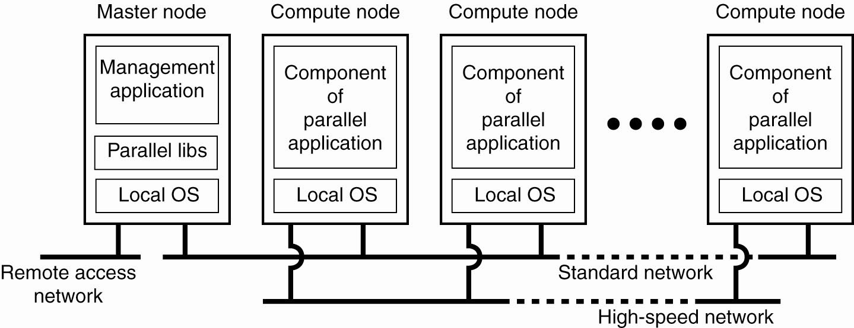
Cluster Computing Systems
Figure 1-6. An example of a cluster computing system.
Tanenbaum & Van Steen, Distributed Systems: Principles and Paradigms, 2e, (c) 2007 Prentice-Hall, Inc. All rights reserved. 0-13-239227-5

Slide 30
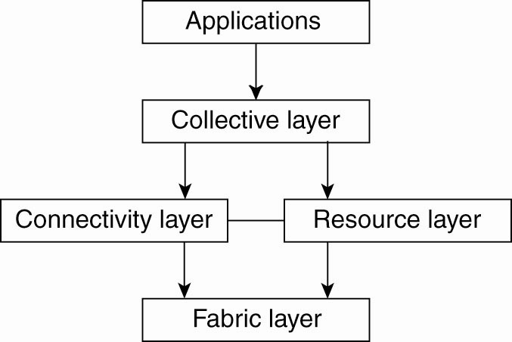
Grid/Cloud Computing Systems
Figure 1-7. A layered architecture for grid computing systems.
Tanenbaum & Van Steen, Distributed Systems: Principles and Paradigms, 2e, (c) 2007 Prentice-Hall, Inc. All rights reserved. 0-13-239227-5

Slide 31
Grid computing Systems
The architecture consists of
Fabric layer
Connectivity layer
Resource layer
Connective layer
Application layer
Tanenbaum & Van Steen, Distributed Systems: Principles and Paradigms, 2e, (c) 2007 Prentice-Hall, Inc. All rights reserved. 0-13-239227-5

Slide 32
Grid computing Systems
Fabric layer:
provides interfaces to local resources at a specific site.
they will provide functions for querying the state and capabilities of a resource, along with functions for actual resource management
Connectivity layer:
consists of communication protocols for supporting grid transactions that span the usage of multiple resources
connectivity layer will contain security protocols to authenticate users and resources
Tanenbaum & Van Steen, Distributed Systems: Principles and Paradigms, 2e, (c) 2007 Prentice-Hall, Inc. All rights reserved. 0-13-239227-5

Slide 33
Grid computing Systems
Resource layer:
responsible for managing a single resource.
It uses the functions provided by the connectivity layer and calls directly the interfaces made
available by the fabric layer
Collective layer:
It deals with handling access to multiple resources and typically consists of services for resource
discovery, allocation and scheduling of tasks onto multiple resources, data replication, and so on
Application layer: consists of the applications that operate within a virtual organization and which make use of the grid computing environment

Slide 34
Distributed Information systems
Transaction Processing system
Enterprise Applications
Tanenbaum & Van Steen, Distributed Systems: Principles and Paradigms, 2e, (c) 2007 Prentice-Hall, Inc. All rights reserved. 0-13-239227-5

Slide 35
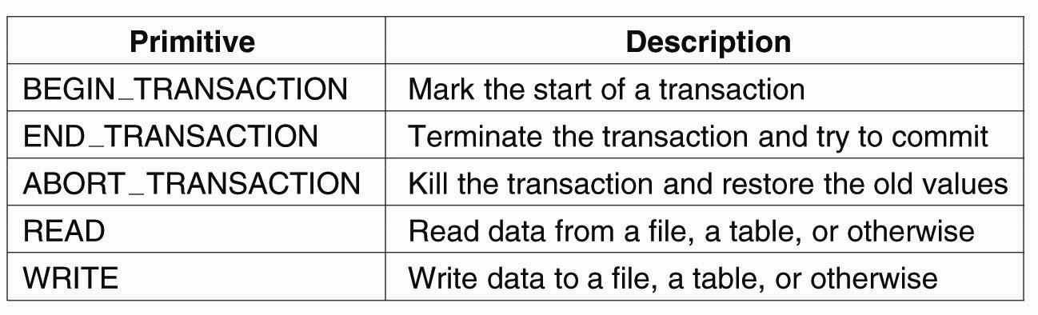
Transaction Processing Systems (1)
Figure 1-8. Example primitives for transactions.
Tanenbaum & Van Steen, Distributed Systems: Principles and Paradigms, 2e, (c) 2007 Prentice-Hall, Inc. All rights reserved. 0-13-239227-5

Slide 36
Transaction Processing Systems (2)
Characteristic properties of transactions:
Atomic: To the outside world, the transaction happens indivisibly.
While a transaction is in progress, other processes cannot see any of the intermediate states.
Consistent: The transaction does not violate system invariants.
If the system has certain invariants that must always hold, if they held before the transaction, they will hold afterward too
Isolated: Concurrent transactions do not interfere with each other.
if two or more transactions are running at the same time, to each of them and to other processes, the final result looks as though all transactions in a sequentially in some order.
Durable: Once a transaction commits, the changes are permanent.

Slide 37
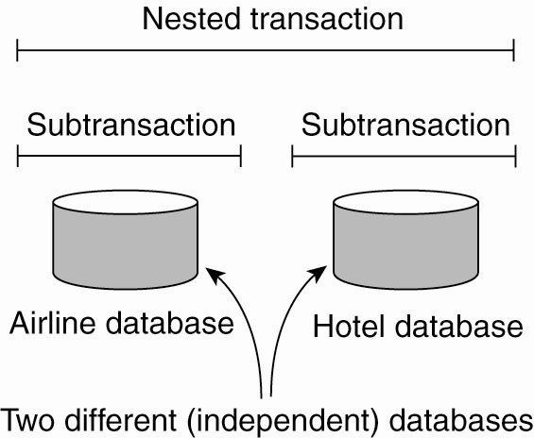
Transaction Processing Systems (3)
A nested transaction is constructed from a number of sub transactions
Nested transactions are important in distributed systems as they provide away of distributing a transaction across multiple machines

Slide 38
Distributed Pervasive Systems
Distributed systems in which instability is the default behavior refer to as distributed pervasive systems
These devices are characterized by being small, battery-powered, mobile, and having only a wireless connection
Tanenbaum & Van Steen, Distributed Systems: Principles and Paradigms, 2e, (c) 2007 Prentice-Hall, Inc. All rights reserved. 0-13-239227-5

Slide 39
Distributed Pervasive Systems
Requirements for pervasive systems
Embrace contextual changes:
means that a device must be continuously be aware of the fact that its environment may change all the time
Encourage ad hoc composition:
many devices in pervasive systems will be used in very different ways by different users. So it should be easy to configure the suite of applications running on a device
Recognize sharing as the default:
devices generally join the system in order to access information. This calls for means to easily read, store, manage, and share information.
Tanenbaum & Van Steen, Distributed Systems: Principles and Paradigms, 2e, (c) 2007 Prentice-Hall, Inc. All rights reserved. 0-13-239227-5

Slide 40
Examples of Pervasive Systems
Home systems
Electronic health care systems
Sensor networks
Tanenbaum & Van Steen, Distributed Systems: Principles and Paradigms, 2e, (c) 2007 Prentice-Hall, Inc. All rights reserved. 0-13-239227-5

Slide 41
Home systems
These systems generally consist of one or more personal computers, but more importantly integrate typical consumer electronics such as TVs, audio and video equipment.
Gaming devices, (smart) phones, PDAs, and other personal wearables into a single system.
In addition, we can expect that all kinds of devices such as kitchen appliances, surveillance cameras, clocks, controllers for lighting, and so on, will all be hooked up into a single distributed system.
There are several challenges that need to be addressed before pervasive home systems become reality.
system should be completely self-configuring and self-managing
Another pressing issue is managing is known as a "personal space."

Slide 42
Electronic Health Care Systems
With the increasing cost of medical treatment,
new devices are being developed to monitor the well-being of individuals and to automatically contact physicians when needed.
In many of these systems, a major goal is to prevent people from being hospitalized.
Personal health care systems are often equipped with various sensors organized
in a (preferably wireless) body-area network (BAN)
Tanenbaum & Van Steen, Distributed Systems: Principles and Paradigms, 2e, (c) 2007 Prentice-Hall, Inc. All rights reserved. 0-13-239227-5

Slide 43
Electronic Health Care Systems
Questions to be addressed for health care systems:
Where and how should monitored data be stored?
How can we prevent loss of crucial data?
What infrastructure is needed to generate and propagate alerts?
How can physicians provide online feedback?
How can extreme robustness of the monitoring system be realized?
What are the security issues and how can the proper policies be enforced?
Tanenbaum & Van Steen, Distributed Systems: Principles and Paradigms, 2e, (c) 2007 Prentice-Hall, Inc. All rights reserved. 0-13-239227-5

Slide 44
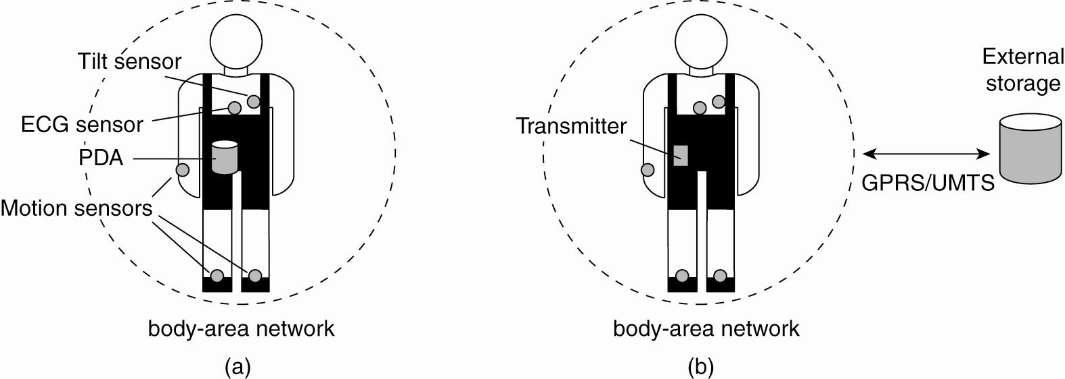
Electronic Health Care Systems
Figure 1-12. Monitoring a person in a pervasive electronic health care system, using (a) a local hub or
(b) a continuous wireless connection.
Tanenbaum & Van Steen, Distributed Systems: Principles and Paradigms, 2e, (c) 2007 Prentice-Hall, Inc. All rights reserved. 0-13-239227-5

Slide 45
Electronic Health Care Systems (1)
Unlike home systems, we cannot expect the architecture of pervasive health care systems to move toward single-server systems and have the monitoring devices operate with minimal functionality.
for reasons of efficiency, devices and body-area networks will be required to support in-network data processing meaning that monitoring data will have to be aggregated before permanently storing it or sending it to a physician.
There is yet no clear answer to these questions
Tanenbaum & Van Steen, Distributed Systems: Principles and Paradigms, 2e, (c) 2007 Prentice-Hall, Inc. All rights reserved. 0-13-239227-5

Slide 46
Sensor Networks (1)
A sensor network typically consists of tens to hundreds or thousands of relatively small nodes, each equipped with a sensing device.
Most sensor networks use wireless communication, and the nodes are often battery powered.
Their limited resources, restricted communication capabilities, and constrained power consumption
demand that efficiency be high on the list of design criteria.
  The relation with distributed systems can be made clear by considering sensor networks as distributed databases.

Slide 47
Sensor Networks
To organize a sensor network as a distributed database, there are essentially two extremes.
. First, sensors do not cooperate but simply send their data to a centralized database located at the operator's site.
Second is to forward queries to relevant sensors and to let each compute an answer, requiring the operator to sensibly aggregate the returned answers.
These solutions are not good as the first one requires that sensors send all their measured data through the network, which may waste network resources and energy.
The second solution may also be wasteful as it discards the aggregation capabilities of sensors which would allow much less data to be returned to the operator

Slide 48
Sensor Networks
Questions concerning sensor networks:
How do we (dynamically) set up an efficient tree in a sensor network?
How does aggregation of results take place? Can it be controlled?
What happens when network links fail?
Tanenbaum & Van Steen, Distributed Systems: Principles and Paradigms, 2e, (c) 2007 Prentice-Hall, Inc. All rights reserved. 0-13-239227-5

Slide 49
Sensor Networks
These questions have been partly addressed in TinyDB, which' implements a declarative(database) interface to wireless sensor networks.
TinyDB can use any tree-based routing algorithm.
An intermediate node will collect and aggregate the results from its children, along with its own findings, and send that toward the root
Tanenbaum & Van Steen, Distributed Systems: Principles and Paradigms, 2e, (c) 2007 Prentice-Hall, Inc. All rights reserved. 0-13-239227-5

Slide 50
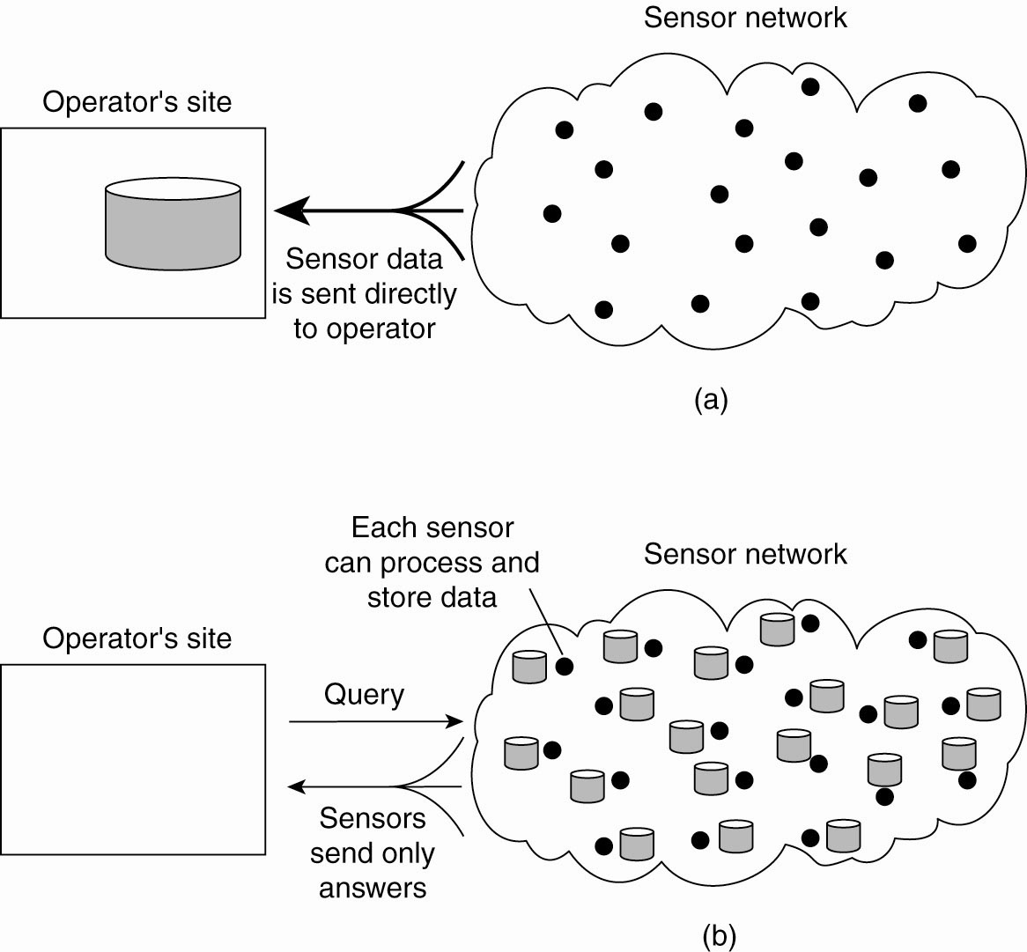
Sensor Networks
Figure 1-13. Organizing a sensor network database, while storing and processing data (a) only at the operator’s site or …
Tanenbaum & Van Steen, Distributed Systems: Principles and Paradigms, 2e, (c) 2007 Prentice-Hall, Inc. All rights reserved. 0-13-239227-5

Slide 51
Sensor Networks
Figure 1-13. Organizing a sensor network database, while storing and processing data … or (b) only at the sensors.
May also do data fusion/aggregation/processing at nodes
along the path to the master node/operator
Tanenbaum & Van Steen, Distributed Systems: Principles and Paradigms, 2e, (c) 2007 Prentice-Hall, Inc. All rights reserved. 0-13-239227-5

Slide 52
Summary
What is distributed systems
Advantages
  easier to integrate different applications running on different computers into a single system
  when properly designed distributed systems scale well with respect to the size of the underlying network
Examples
Goals
Types of Distributed systems

